Slide 1
Computation Intelligence
Feature Selection Problem
Dec. 13th, 2022
Student ID: 44221516
Ouyang Shiyu
1

Slide 2
Content
01
Topic analysis
02
Regression
03
GA algorithm
04
Results
2

Slide 3
1. Topic analysis
3

Slide 4
Target
1. A suitable regression model
2. More efficient GA algorithm
3. Features after selection

Slide 5
2. Regression
5

Slide 6
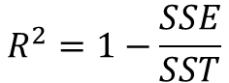
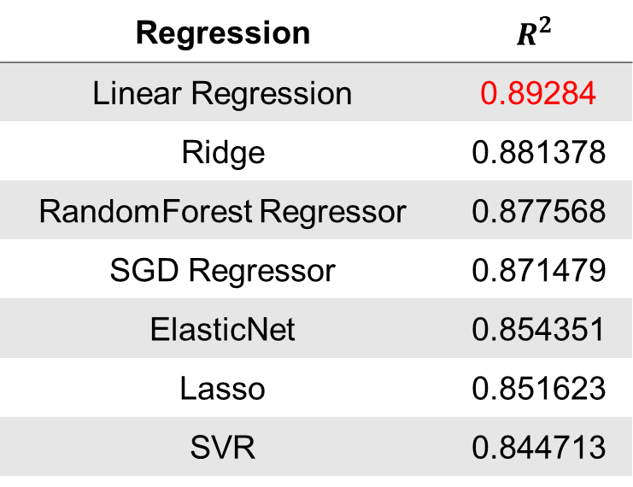
Regression method choose
Regression | $$R^{2}$$
Linear Regression | 0.89284
Ridge | 0.881378
RandomForest Regressor | 0.877568
SGD Regressor | 0.871479
ElasticNet | 0.854351
Lasso | 0.851623
SVR | 0.844713
Evaluation Metric
$$R^{2}=1−\frac{SSE}{SST}$$
6

Slide 7
3. GA algorithm
7

Slide 8
Algorithm process
Population Initialization
a binary string
0/1 indicates the presence/absence of the ith feature in the solution.
Roulette Wheel Selection
Elitism
Stopping Conditions
The variance of fitness values in a population reaches Maxtolerance
One Point Crossover
Constant Crossover probability
The algorithm stops when the number of generations reaches MaxGenerations
Constant Mutation probability
8

Slide 9
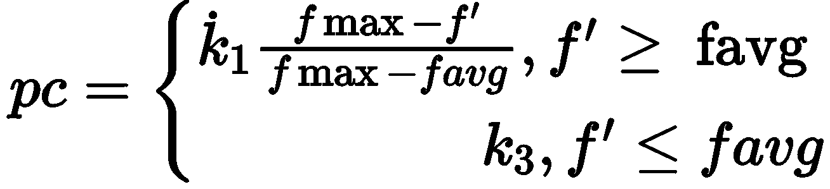
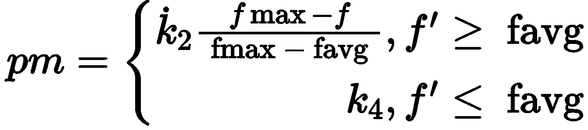
Adaptive GA algorithm
Constant crossover and mutation probabilities
01
Different fitness applies different crossover and mutation probability
02
Different iteration use different crossover and mutation probabilities
Crossover probability
Mutation probability
9

Slide 10
4. Results
10

Slide 11
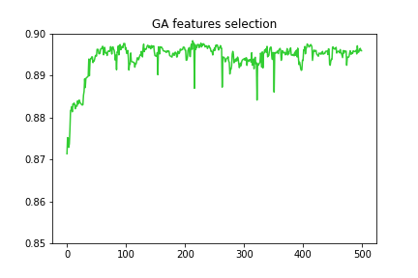
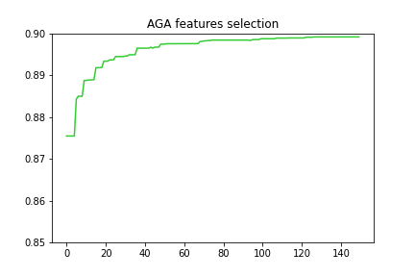
Comparison results
11

Slide 12
Thank you

